Slide 1


Low-Power, Long-Range Communication for IoT
Course Title: Wireless Communication
Presented by:
Supervised by:
Md. Emon Hasan (ID: IT-21015)
Dr. Md. Nazrul Islam
4th Year, 2nd Semester, Dept. of ICT
Associate Professor, Dept. of ICT
Mawlana Bhashani Science and Technology University (MBSTU)

Slide 2

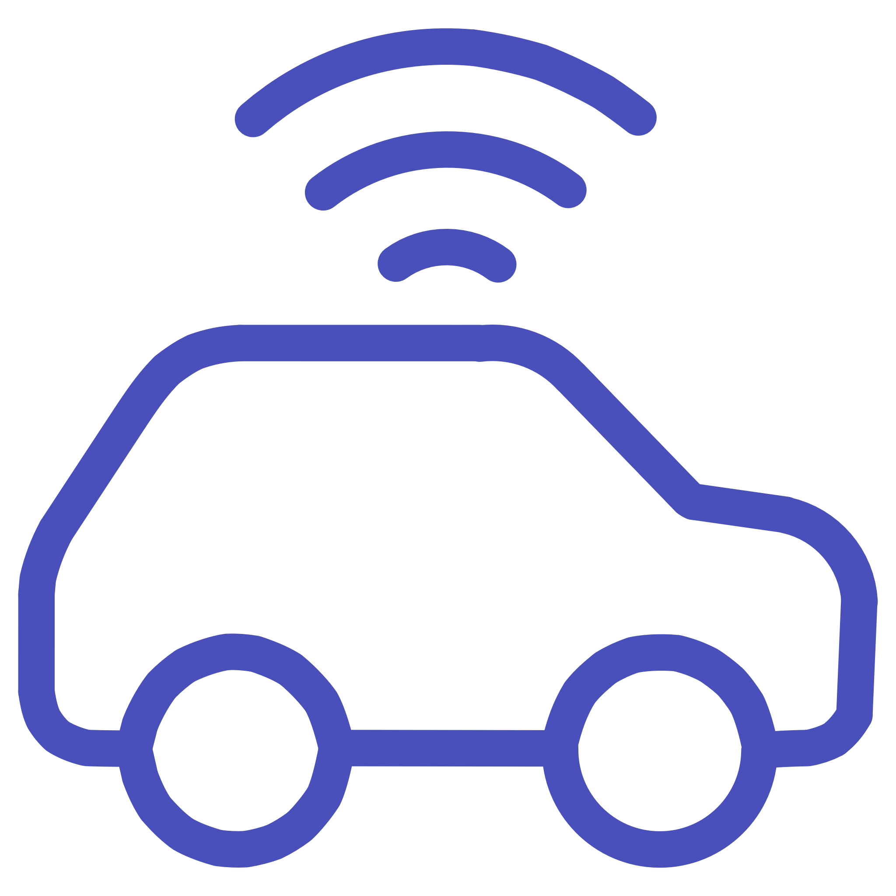
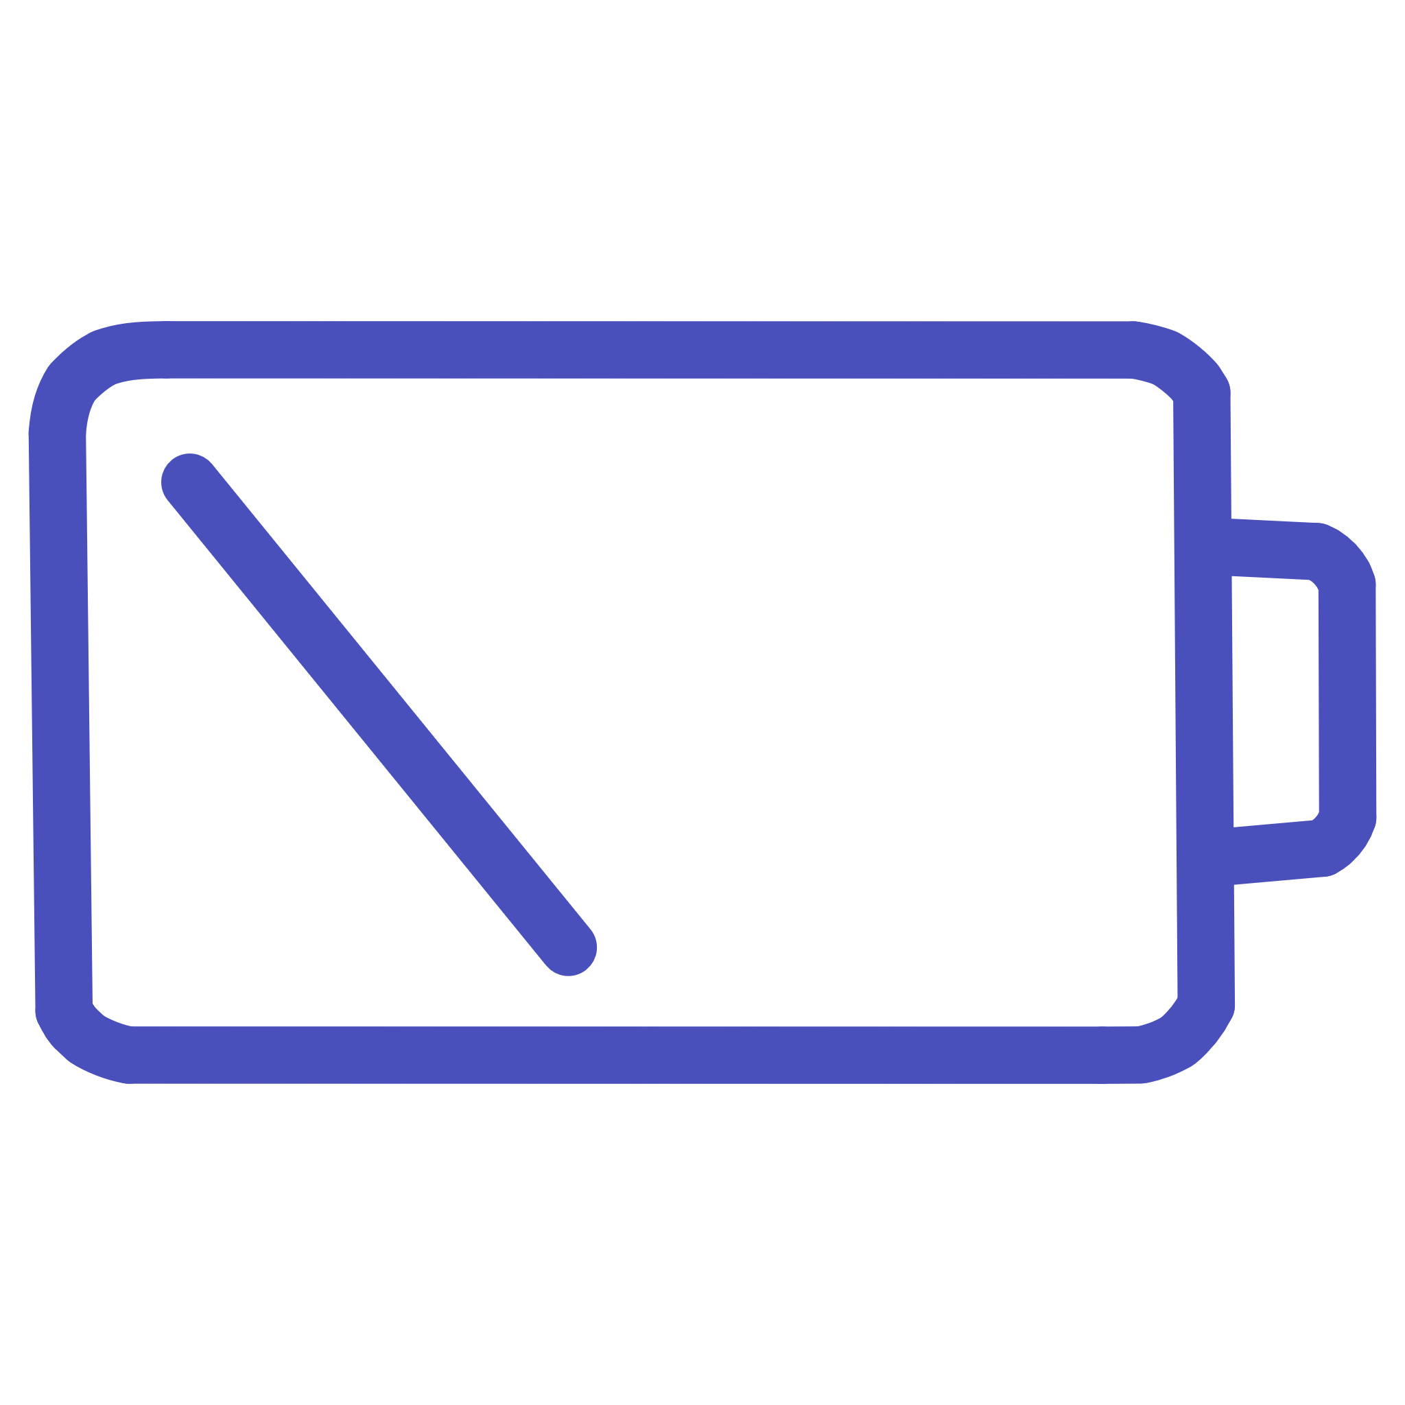
The Foundation: Understanding the Internet of Things (IoT)
What is IoT?
Common Examples
Communication Challenge
A network of physical objects ("things") embedded with sensors, software, and other technologies to connect and exchange data over the internet.
Smart homes, fitness trackers (wearables), industrial sensors, and connected vehicles are all typical IoT devices.
Many IoT devices are remote and battery-powered, requiring communication that uses very little power over long distances.

Slide 3
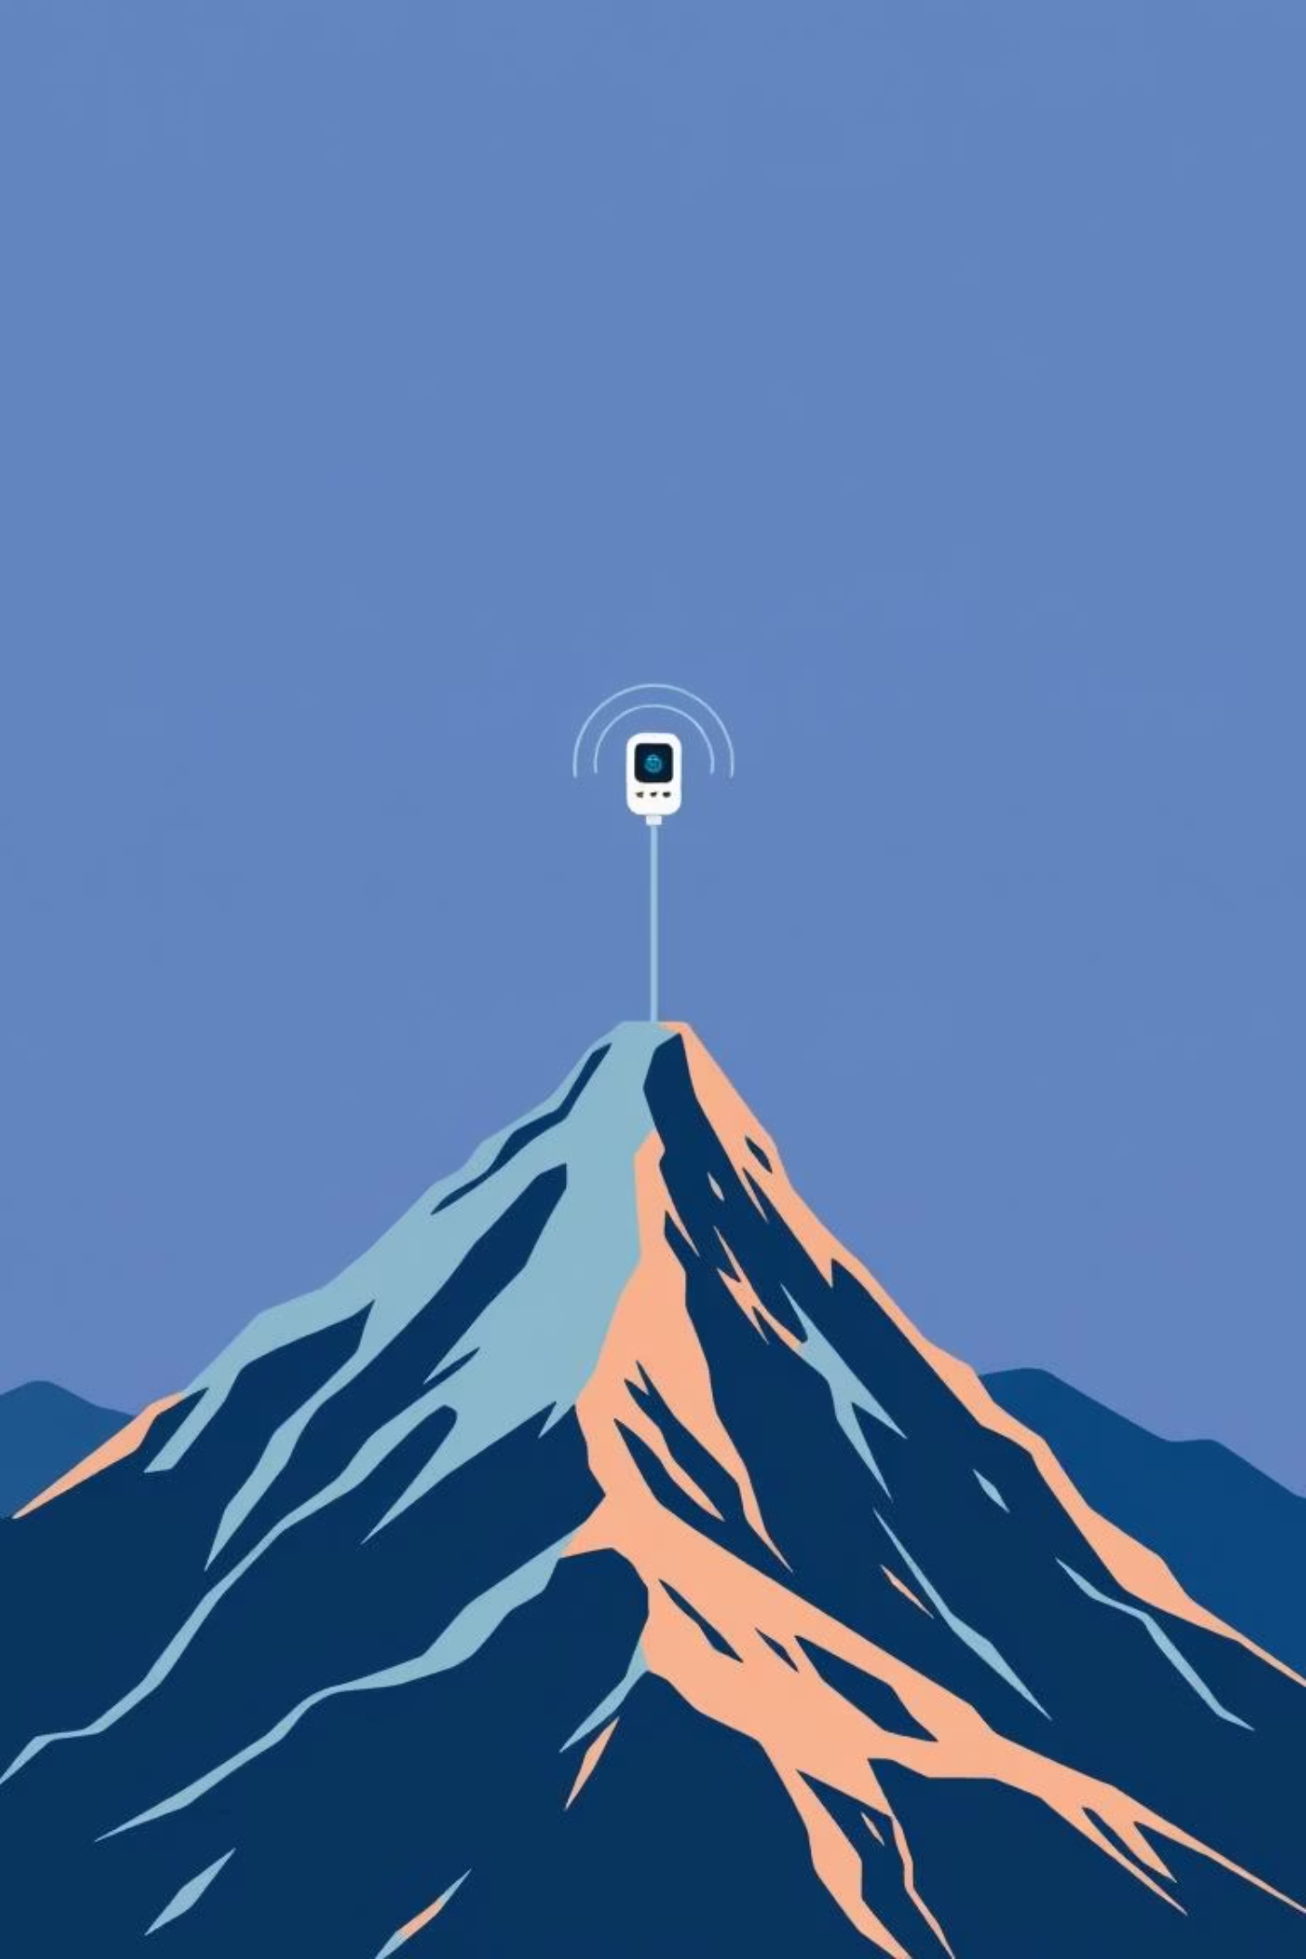

The Core Problem: Communication Challenges in IoT
Limited Battery Life
Sensors must last for years without human intervention, making energy consumption critical.
Distance and Connectivity
Traditional Wi-Fi or Bluetooth only cover short distances. IoT needs connectivity across kilometers.
Cost and Coverage
Deploying and maintaining vast networks of devices requires low-cost solutions and broad network availability.
This leads to the crucial need for Low-Power Wide-Area Networks (LPWAN).

Slide 4
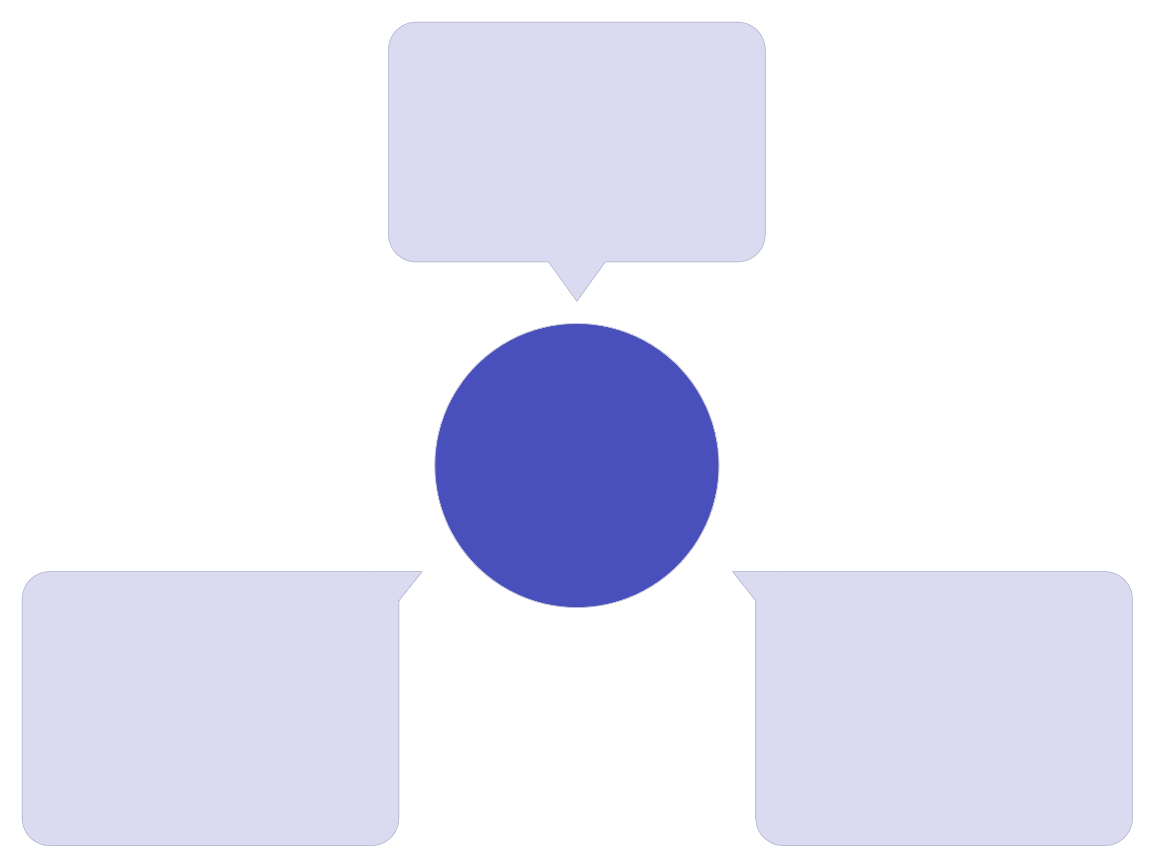
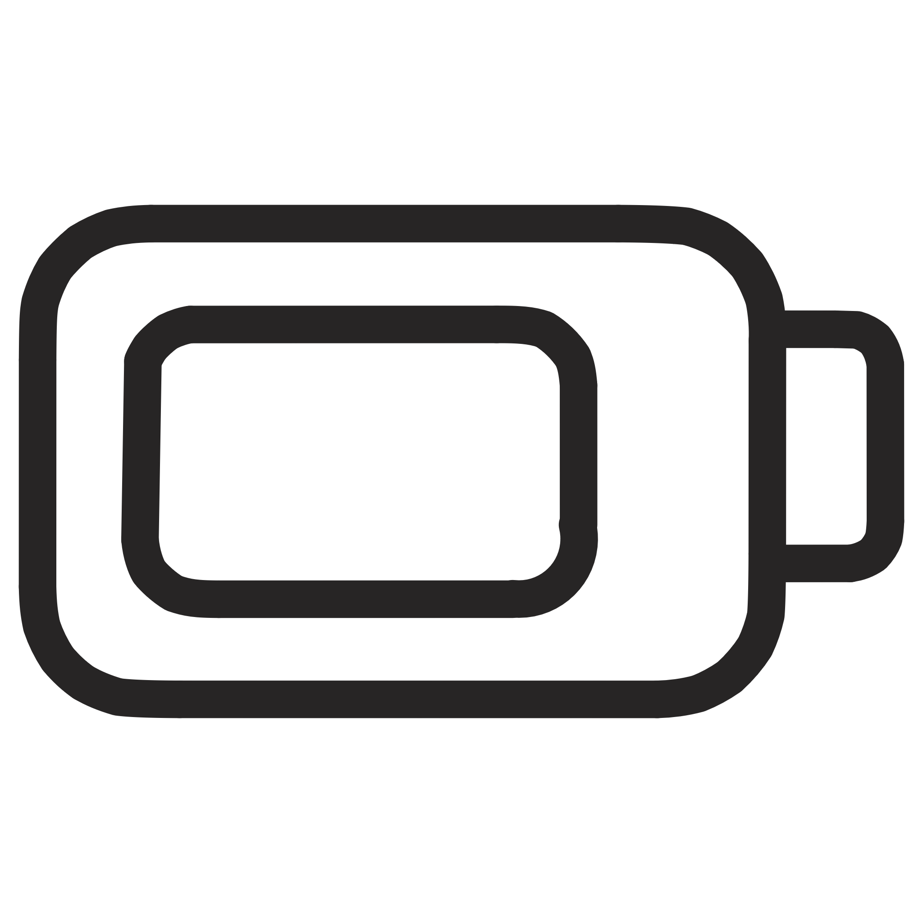
LPWAN: The Solution for Long-Range IoT
LPWAN
Low-power wide-area network
IoT Requirement
NB-IoT
LoRaWAN
Carrier-grade, deep coverage
Unlicensed, long-range
What is LPWAN?
Why LPWAN is Ideal
LPWAN stands for Low-Power Wide-Area Network. It's a type of wireless network designed to enable communications over a long range at a low bit rate.
It delivers the key characteristics required for most IoT use cases: extended battery life, long-range coverage, and low hardware cost.
The two leading LPWAN technologies are LoRaWAN and NB-IoT.

Slide 5
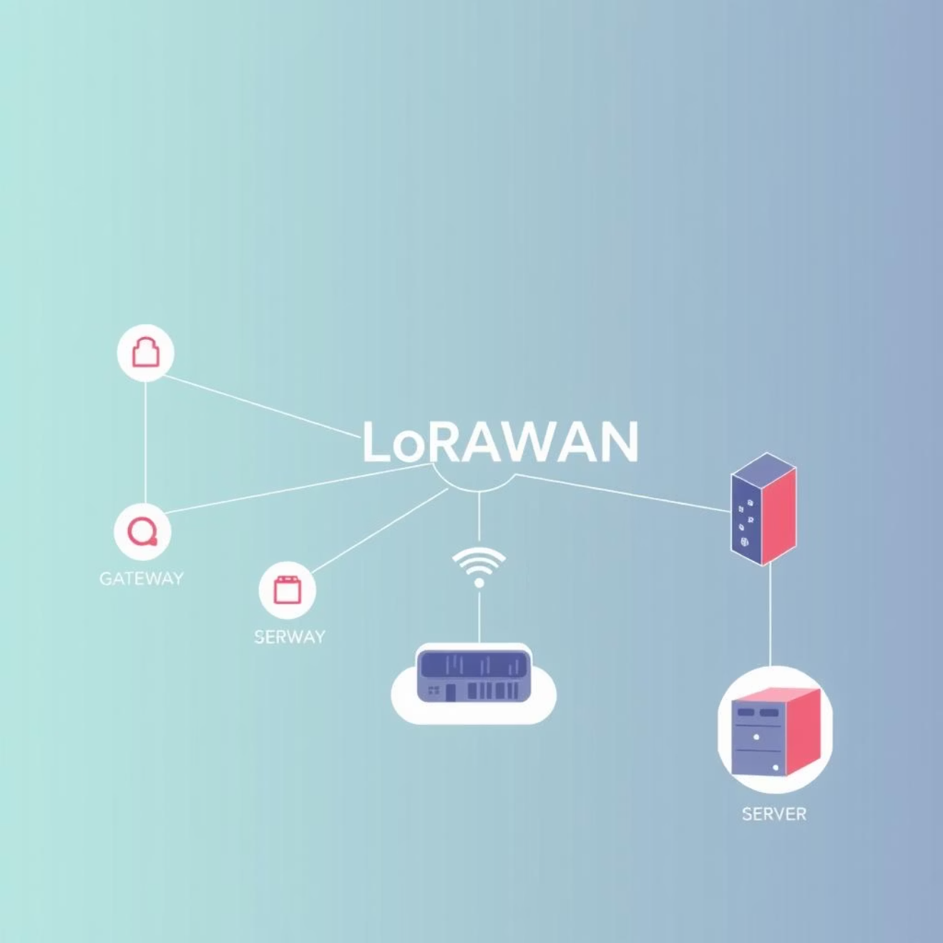

Deep Dive: LoRaWAN (Long Range Wide Area Network)
Key Features and Structure
Long Range: Can connect devices miles apart, even in challenging environments.
Low Power: Designed to maximize device battery life (often 5-10 years).
Unlicensed Spectrum: Operates on frequency bands that do not require an operator license, reducing operational costs.
Network Flow: End Nodes send data to Gateways, which forward it to a central Network Server, and finally to the Cloud application.
LoRaWAN excels in large-scale, private network deployments in remote areas.
Typical uses include smart agriculture monitoring (soil, weather) and wide-area environmental sensing.

Slide 6
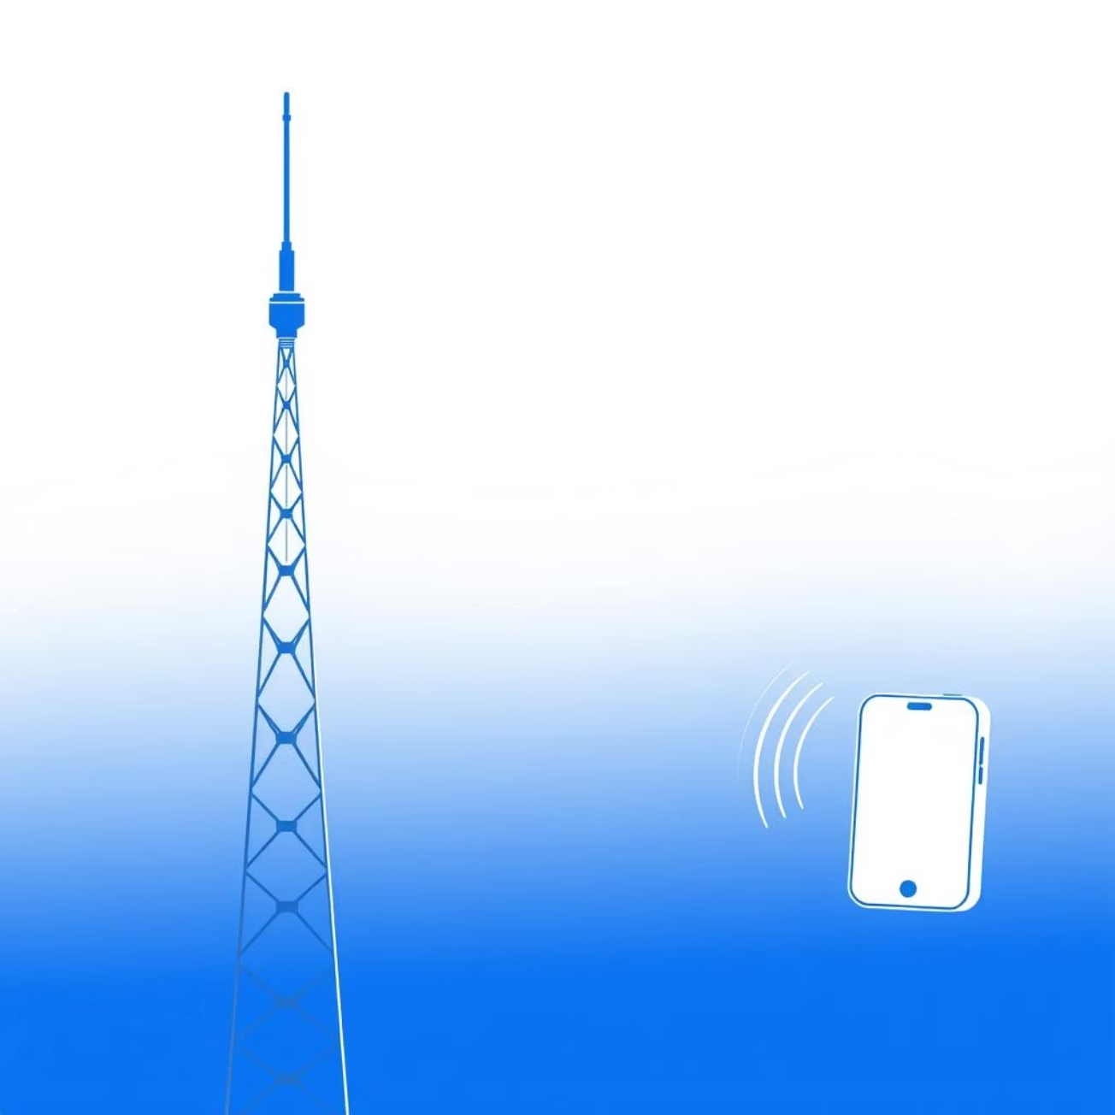

Deep Dive: NB-IoT (Narrowband Internet of Things)
Key Features and Infrastructure
Cellular Based: NB-IoT runs on the existing cellular network (4G/5G infrastructure).
Strong Reliability: Offers high quality of service and secure, carrier-grade connections.
Indoor Penetration: Excellent signal strength, allowing devices to connect deep inside buildings (e.g., utility meters in basements).
Licensed Spectrum: Utilizes licensed cellular frequencies, ensuring minimized interference and dedicated bandwidth.
NB-IoT is highly suited for urban environments where cellular coverage is guaranteed.
Popular for applications like smart utility metering, remote asset tracking, and smart parking solutions.

Slide 7
LoRaWAN vs. NB-IoT: Head-to-Head Comparison
Selecting the right technology depends on the application's environment and requirements.
Feature
LoRaWAN
NB-IoT
Network Type
Unlicensed Spectrum (Open)
Licensed Spectrum (Cellular)
Range
Excellent (2–15 km)
Good (1–10 km)
Cost to Deploy
Lower (Private networks)
Moderate (Carrier subscription)
Power Consumption
Very Low
Low
Ideal Environment
Rural/Remote areas, large private estates
Urban areas, indoor deep coverage

Slide 8




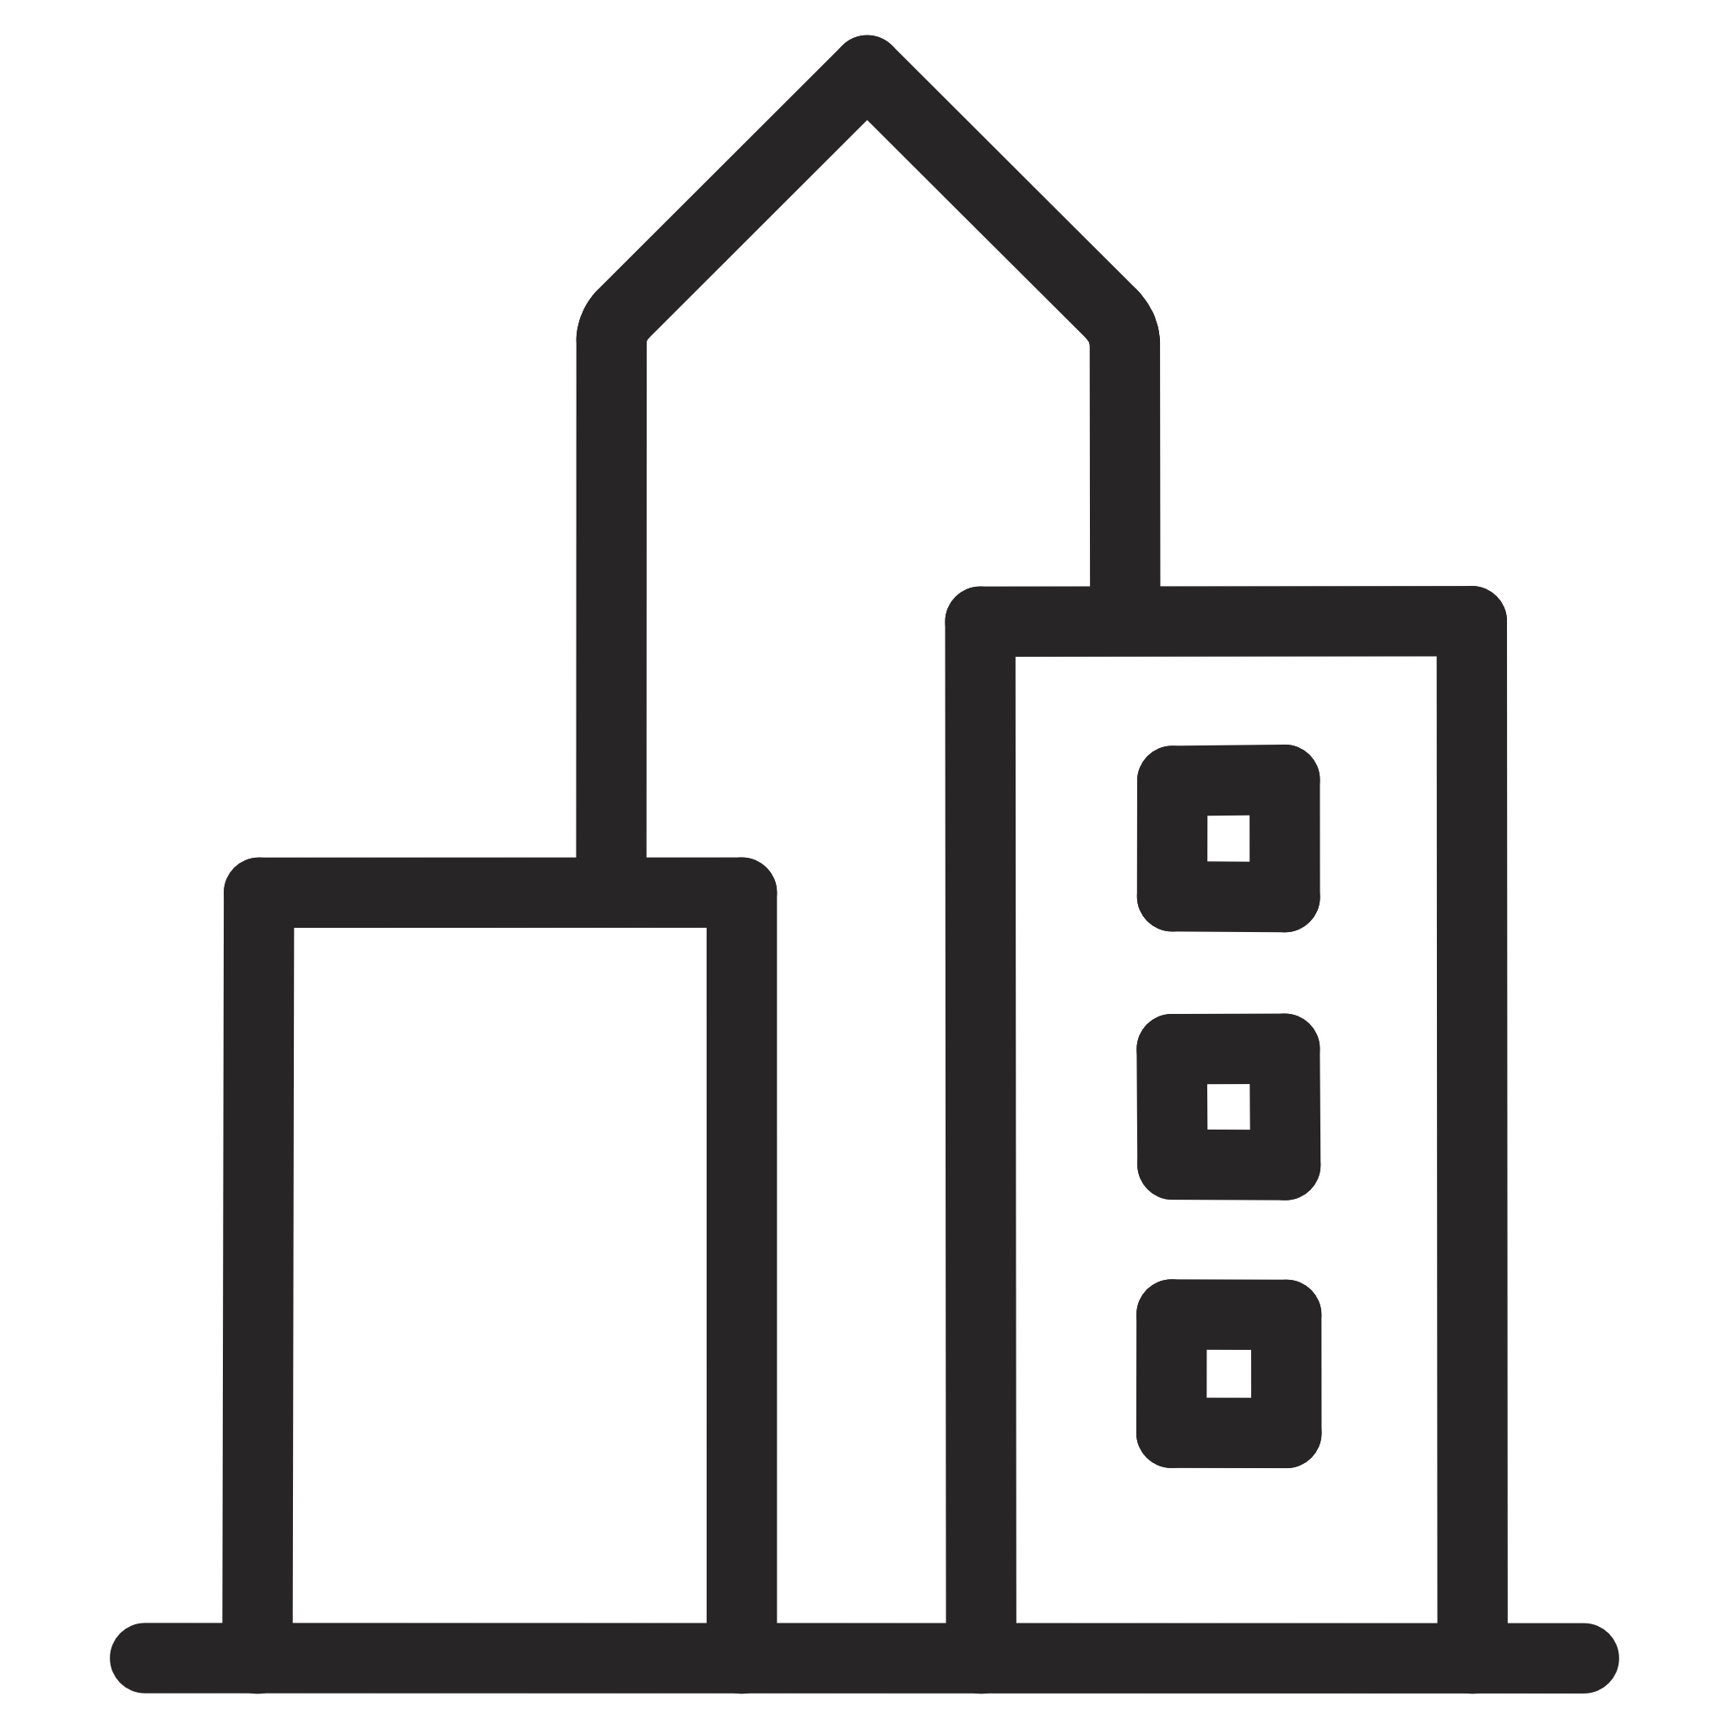


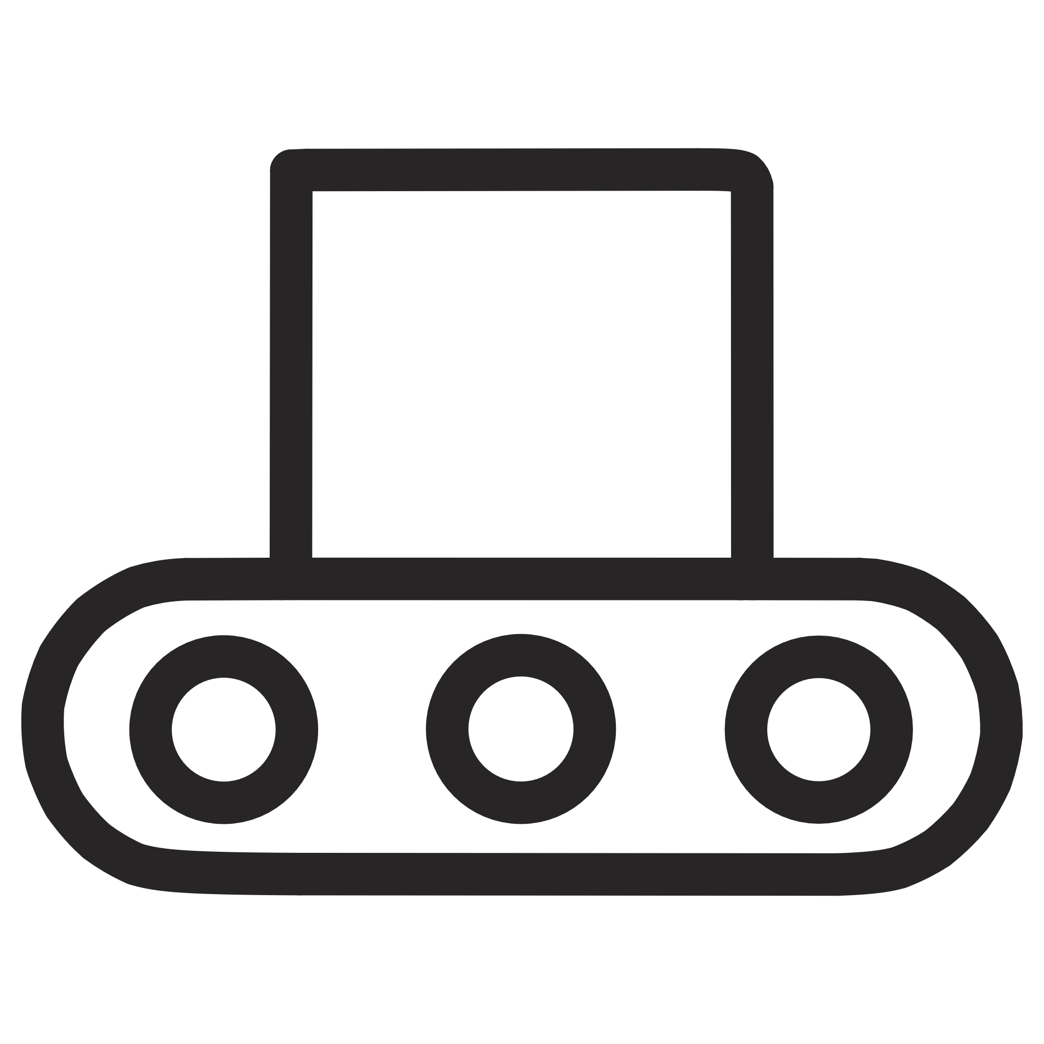
Transformative Applications in the Real World
LoRaWAN and NB-IoT are powering the next generation of connected services across multiple sectors.
Smart Cities
Smart Agriculture
Managing street lights, optimizing waste collection, and monitoring air quality.
Precision farming, tracking livestock, and monitoring soil health parameters.
Healthcare
Industrial IoT (IIoT)
Wearable health monitoring for the elderly and remote patient tracking.
Asset tracking, predictive maintenance, and supply chain logistics.

Slide 9



The Future Scope of LPWAN Technologies
These technologies are continuously evolving to handle the immense scale of the connected world.
Billions of Devices
Scaling infrastructure to support an estimated 75+ billion devices connected globally by 2025.
5G Integration
Integrating NB-IoT and LoRaWAN with the high-speed and massive connection capabilities of 5G networks.
Improved Energy Efficiency
Developing even more power-efficient chipsets and communication protocols for prolonged sensor life.

Slide 10

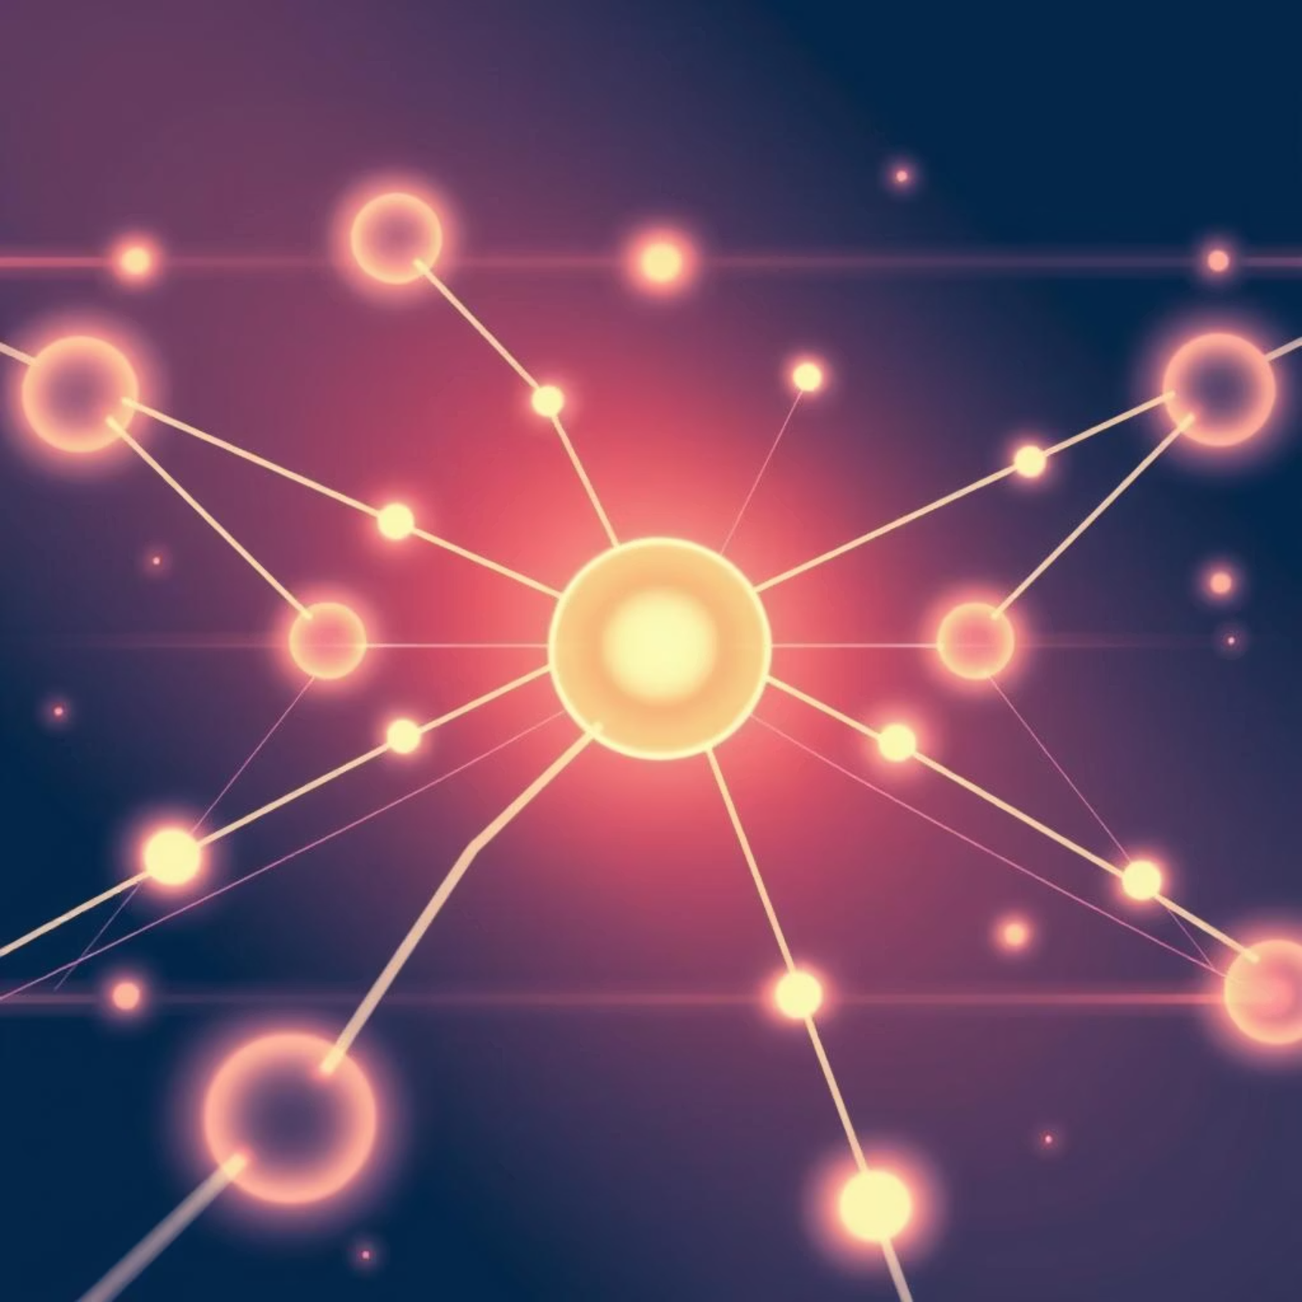

Conclusion: A Dual Approach to a Smarter World
Key Takeaways
Thank You!
LoRaWAN: Flexible, long-range, and highly cost-effective for private or massive open area coverage.
NB-IoT: Reliable, secure, and easily scalable using existing licensed cellular infrastructure.
Both LoRaWAN and NB-IoT are fundamental drivers of IoT adoption, each dominating different deployment scenarios to ensure maximum coverage and efficiency.

